Slide 1

FOOD DELIVERY WEBPAGE
PROJECT MENTOR
REEMA PHALKE
TEAM MEMBERS
ADITYA CHAVHAN (SE-B-25)
PRIANSHU KHALDE (SE-B-23)
VIKAS TARANGE (SE-B-27)
TEJASKUMAR CHOPADE (SE-B-09)
SANKET DUBAL (SE-B-08)

Slide 2
GOAL OF THE PROJECT
To easily order food from home online within a few clicks

Slide 3
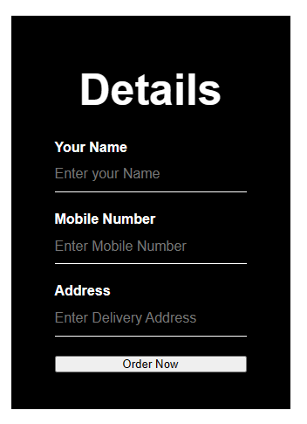
INTRODUCTION
This system deals with ordering, processing and delivering food products.
Ordering is done by a valid customer with appropriate identity.
The administration receives order, acknowledges the customer, process them and assure correct delivery.

Slide 4
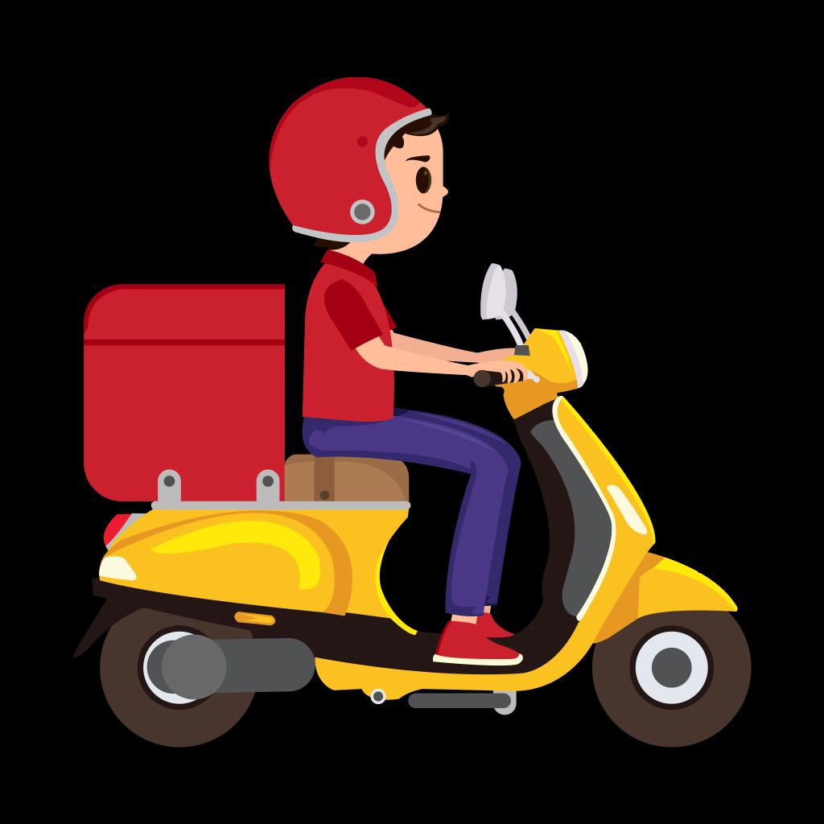




MARKET SITUATION ANALYSIS
About 20,000 orders are delivered a day.
Number of orders is increasing 10 times every year.
Minimum delivery charge is Rs.50/-
The sector has already created over 10,000 jobs.

Slide 5
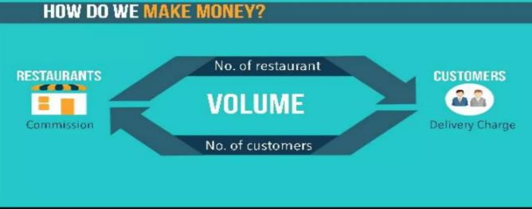
EMPLOYMENT
Online food delivery network already created 10,000 jobs in India.
Most of the riders are students who are doing it part time.
Vendors are making food profit and they are also hiring more employees so that they make fast food delivery.

Slide 6
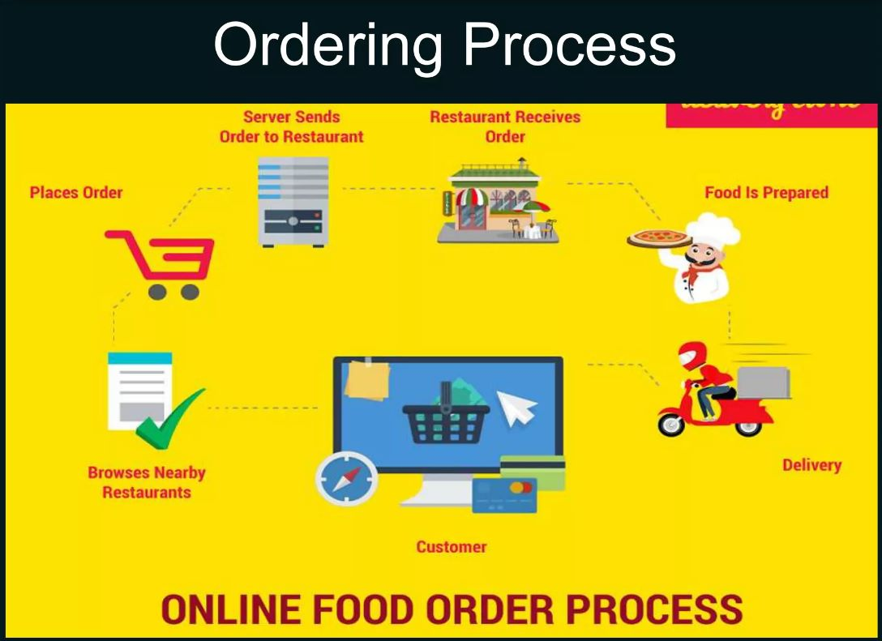
ORDERING PROCESS

Slide 7

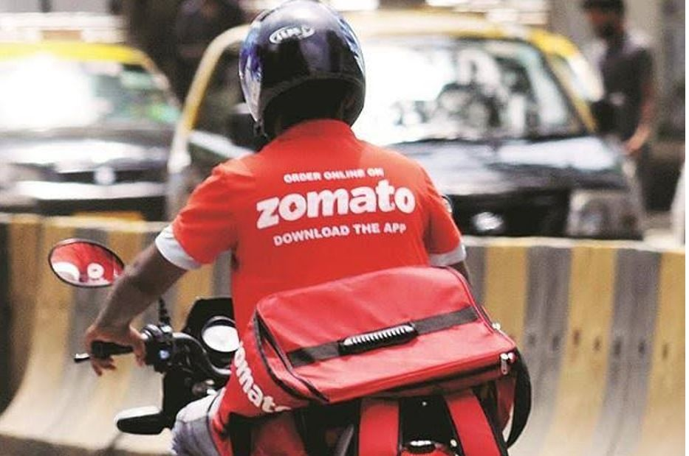
DELIVERY PROCESS
Receive order details
Immediately notifies Restaurant
Delivery
personnel
collects ordered food
Delivery is made and payment is collected

Slide 8
SETBACKS AND CHALLENGES
Lack of Infrastructure.
Well-funded competition logistics challenges.
Threat of New Entrants is medium to high.
Threat of substitutes moderate to high.
Bargaining power of buyers is low to moderate.
Bargaining power of suppliers is medium to high.
Online Payment.

Slide 9


TOOLS AND PLATFORM
We have used HTML and CSS programming languages for making this online food delivery webpage of restaurant.
This system can be executed on any platform. It is a platform independent system.

Slide 10
THANK YOU

